Slide 1

Data structures using C
Module 4 - Lecture IV
Trees
Prepared By
Ms. Smriti Sehgal

Slide 2
Threaded Tree
In a linked representation of binary tree, null links can be replaced by pointers, called ‘threads’ to other nodes.
A left null link of the node is replaced with the address of its inorder predecessor.
A right null link of node is replaced with the address of its inorder successor.

Slide 3
Threaded Tree
Binary trees have a lot of wasted space: the leaf nodes each have two null pointers.
We can use these pointers to help us in inorder traversals.
We have the pointers reference the next node in an inorder traversal; called ‘threads’.
We need to know if a pointer is an actual link or a thread, so we keep a Boolean for each pointer.

Slide 4
Types
Single Threaded: Where a NULL right pointers is made to point to the inorder successor (if successor exists)
Double Threaded: Where both left and right NULL pointers are made to point to inorder predecessor and inorder successor respectively. The predecessor threads are useful for reverse inorder traversal and postorder traversal.
struct Node
{
int data;
struct Node *left, *right;
bool rightThread;
}

Slide 5
void inOrder(struct Node *root)
{
struct Node *cur = leftmost(root);
while (cur != NULL)
{
printf("%d ", cur->data);
if (cur->rightThread)
cur = cur->right;
else cur = leftmost(cur->right);
}
}
struct Node* leftMost(struct Node *n)
{
if (n == NULL)
return NULL;
while (n->left != NULL)
n = n->left;
return n;
}

Slide 6
Double Threaded Binary Tree
Threading Rules:
Right Child field at node ‘x’ is replaced by a pointer to the node that would be visited after ‘x’ when traversing the tree in inorder. That means, it is replaced by the inorder successor of ‘x’.
Left Child link at node ‘x’ is replaced by a pointer to the node that immediately precedes node ‘x’ in inorder (i.e., it is replaced by the inorder predecessor of ‘x’).

Slide 7
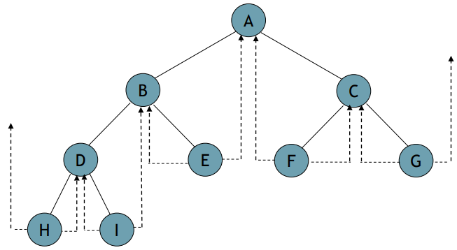
Threaded Tree Diagram
Inorder Sequence: H, D, I, B, E, A, F, C, G

Slide 8
Threads
To distinguish between normal pointers and threads, two boolean fields, ‘LeftThread’ and ‘RightThread’ are added to the record in memory representation.
t->LeftChild = true
=> t->LeftChild is a thread
t->LeftChild = false
=> t->LeftChild is a pointer to the left child.

Slide 9
Threads
To avoid dangling threads, a head node is used in representing a binary tree.
The original tree becomes the left subtree of the head node.
LeftThread
LeftChild
data
RightChild
RightThread
True |  |  |  | False

Slide 10
Traversal (Threaded Tree)
Start at the leftmost node in the tree, print it, and follow its right thread.
If we follow a thread to the right, we output the node and continue to its right.
If we follow a link to the right, we go to the leftmost node, print it, and continue.

Slide 12
Advantages (Threaded Binary Tree)
Non-recursive preorder traversal can be implemented without a stack.
Non-recursive inorder traversal can be implemented without a stack.
Non-recursive postorder traversal can be implemented without a stack.

Slide 13


